Slide 1
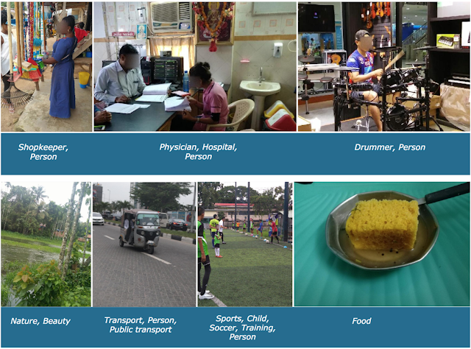
Development of Robust Image Classifiers for Geo-diverse Distributions
Alex Shoop, Claire Danaher, Clayton Dembski, Saina Rezvani
Notes:
Direct Kaggle reference link: https://www.kaggle.com/c/inclusive-images-challenge

Slide 2
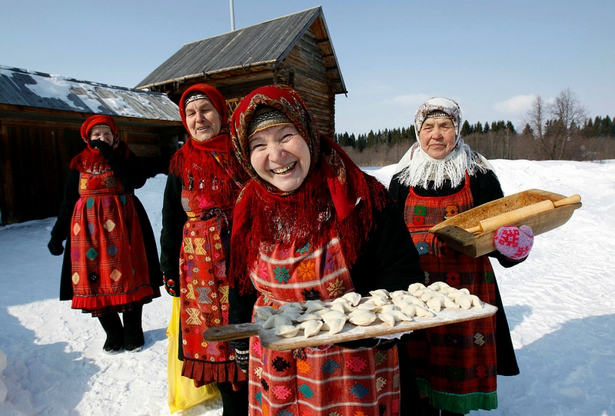
Motivation
The effectiveness of modern machine learning image classifiers is heavily dependent on the representativeness of the corpus
Commonly used image datasets are eurocentric and perform poorly on non-euro images
Motivation for this project was to explore modeling approaches that were less susceptible to this bias

Slide 3
Data Extraction
Image Extraction
Open Images Dataset is publically available data of text documents containing object labels and urls to images
Images extracted to GCP storage bucket via web scraping the urls
Raw Images
1.2M color images with sizes as large as over 1200X1200 pixels of varying image dims dimensions
Image Subsets
Train/Test: 8 image classes, 36,000 images from euro-centric training data set, split into training and testing data
Train/Tune: 8 image classes, 36,000 images from euro-centric training data set for training, tuning data of 250 non-eurocentric images provided by Kaggle

Slide 4
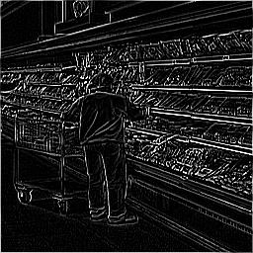
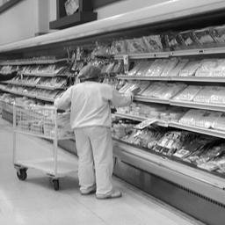
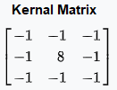
Image Processing
Dimension Reduction- Resize images to a smaller standardize dimensions of 256X256
Grayscale Images- Average RGB values per pixel
Edge Images- Apply kernel transformations
Notes:
Motivation for greyscale
1: easier and faster to process 2: reduces number of hues we need to worry about, instead reducing to just the tones.
Motivation for edges
By getting rid of tonality completely, we focus only on the shapes of objects: We don’t need to worry about the skin tone of a person, or the coloration of an object, we only care about the object’s outline

Slide 5
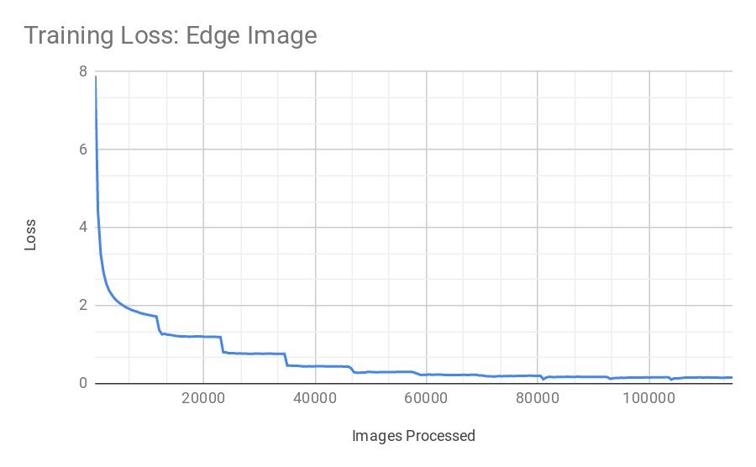
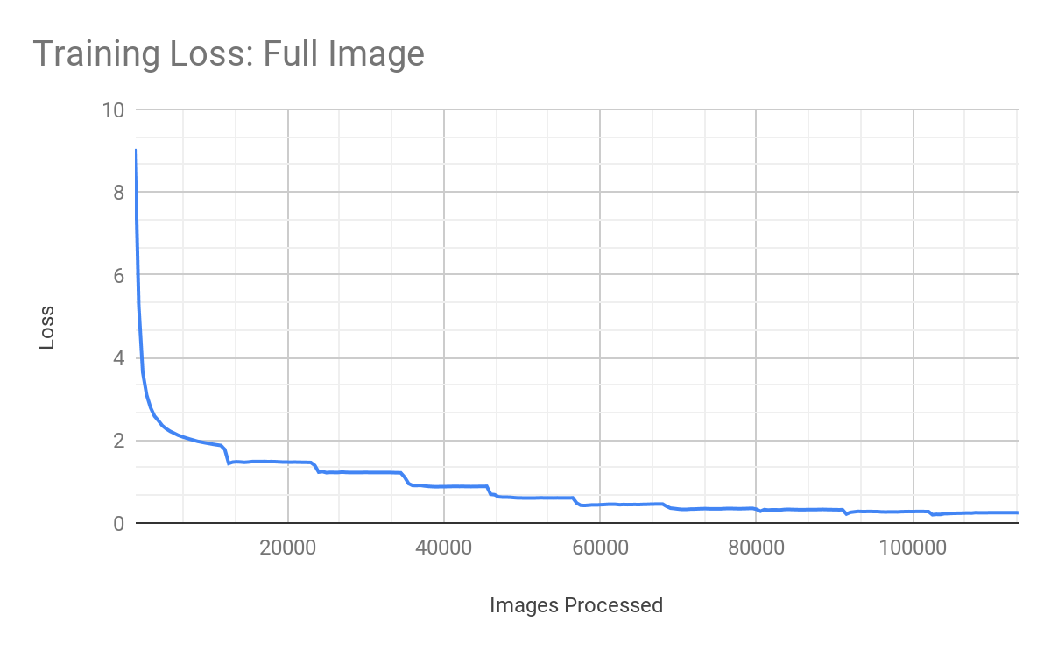
Modeling- Convolutional Neural Network
Layers
Convolutional(2) --- apply convolution operation to the input
Max Pool(1) --- a 2x2 pooling filter across the previous layer and taking the max of the 4 values in the 2x2 filter
Dropout(1) --- reduce the possibility of overfitting
Activation Functions
Hidden Layers- Relu
Output Layer- Softmax
Notes:
-max pooling works by sliding a 2x2 pooling filter across the previous layer and taking the max of the 4 values in the 2x2 filter. -For our training, we did 10 batches of 10,000 bootstrapped images.
-why did we choose such a small number of layers for our cnn?

Slide 6
Challenges
Open Images Data Set
Images are extremely large and require pre-processing
Images are noisy real world images- multiple objects
Big Data Development Environment
Used Google Colab linked into google cloud bucket for development work via blob downloads
Code reformatted and deployed to the Google’s ML Engine for production
Working within the google cloud environment required a significant amount of technical troubleshooting and time investment
Other Methods
Our team explored generative models. These approaches proved problematic due to two factors: complexity of the images and size of the data set
Notes:
-> Keeping all of the info together was a pain: difficult to keep images with image ids with bounding boxes -> TIME: downloading all images took 20 hours
Cropping took 6.5 hours per set
Training took an upwards of 20 hours for 36000 miniset (due to error in code, rerunning training twice) Training took 4 hours for 3600 images
Testing was a pain-> would fail after an hour and need to be edited and rerun. Deployment ticked off minutes of time
-> We would not directly read/write to our bucket w/o deploying to an engine. Lead to inefficiencies Blob testing, download images to run
Deployment testing
-> Default storage limits for ML engine resources: Had multiple jobs running for upwards of 8 hours crash because: We ran out of “ml units” for that particular region, and had to restart the job
We ran out of space on the engine, crashing all running jobs at the time.
Set us back at least a day and a half
Meant we physically couldn’t run the batch of ALL images w/o rewriting code.

Slide 7
Findings
Hypothesis- edged images would retain structure and remove noise and therefore would perform better on the tuning data
Results-models tuned on the edge images performed better on euro images whereas the models tuned with the full images performed better on non-euro images
 | Accuracy
 | Train/Test Images | Train/Tune Images
Full Images | 72% | 41%
Edge Images | 73% | 37%
Notes:
Accuracy by Method Train/Test Split Full Image 0.7228127555192151 Edge Image 0.7307168165712729 Train/Tune Split Full Image 0.4143920595533499 Edge Image 0.37965260545905705

Slide 8
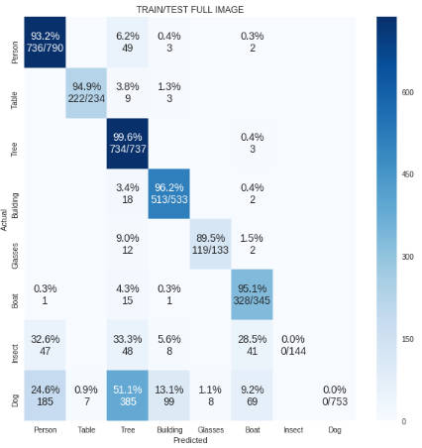
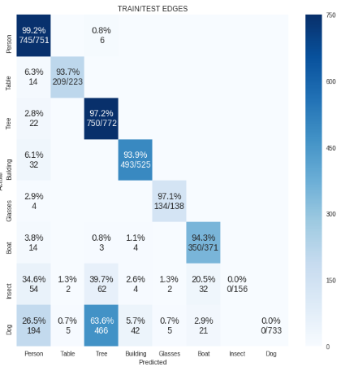
Results- Train/Test Validation Set

Slide 9
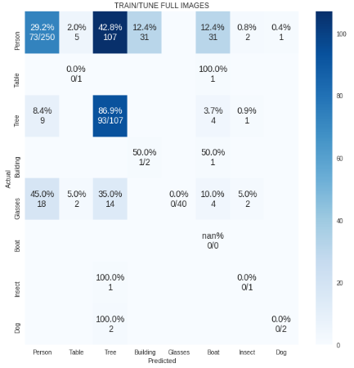
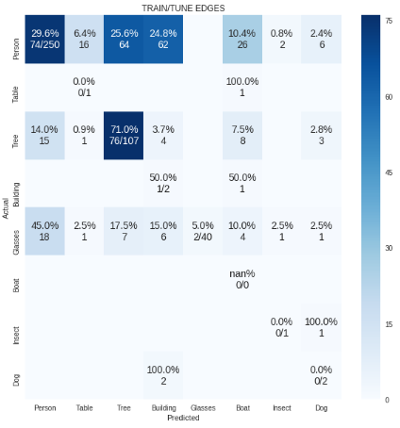
Results- Train/Tune

Slide 10
Thank you!
Q&A

Slide 11

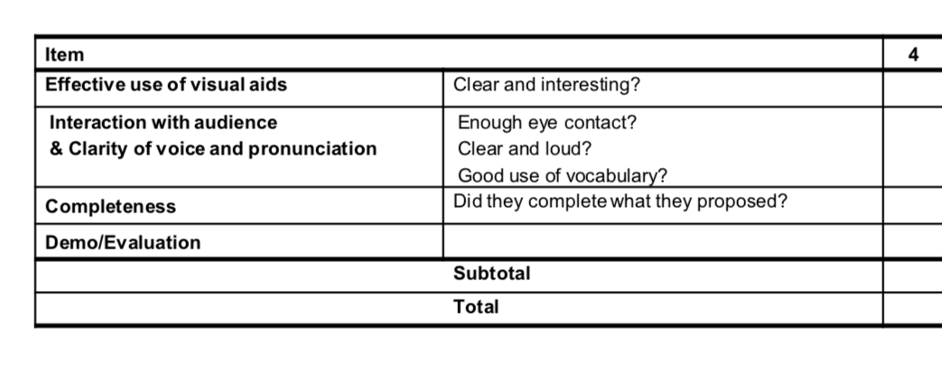




This is the evaluation form that the prof will hand out in-class
App engine
GCS
ML engine
Notes:
This slide will not show when presenting, but it’s for notes purposes

